Slide 1

CAPSTONE PROJECT EDA ON NYC AIRBNB BOOKING

Slide 2



TEAM PRESENTATION
Vinayak Marathe
Riya Patel
Shrivatsa Sagar Namdeo
Muskan Kasare

Slide 3
Introduction
Problem Statement and Business Case
Data Explanation and Preparation (Understanding of data)
Data Wrangling (EDA) & Data Visualization with Business Insights
Competitive Advantages and Future Work
Conclusion

Slide 4
Introduction (Cont.)
ROADMAP
What is Airbnb?
Problem Statement
Data Wrangling
Competitive Advantages & Future Work
1
3
5
2
4
6
Data Explanation & Preparation
Data Visulization
Conclusion

Slide 5
What is Airbnb?
1
Problem Statement

Slide 6
What is ?
AirBnb is identify for "Air Bed and Breakfast", is a American online hospitality company focused on short time length homestays or rental platform. On Airbnb, users can book a nearby to stay as accordance to their convenient in more than 34000+ cities at some aspect of 200+ countries. Airbnb used to started in 2008 by Brian Chesky and Joe Gebbia, specifically based in San Francisco California. Airbnb platform is reachable via mobile app and website.
The company does not own any lodging, even it is a type of broker which receives percentage services fees from both the party(guest & host) with every booking.

Slide 7
Problem Statement
The objective of the project is to perform an exploratory data analysis, data pre-processing, data cleaning & imputation and at the end, apply different Data Visualization techniques to get the meaningful insight from the given data. This project aims apply some amazing Python Libraries such as Folium and WordCloud which will give a boost to our visual understanding of the data.
These thousands and lots of records generate a lot of statistics/data and this data can be analyzed, used for security, grasp of customers/providers behavior, business preferences & performance on the platform, implementation of modern additional service and for a lots of things. we are analyzing the various aspects with different use cases which covers many aspects of Airbnb listings.

Slide 8
Business Case
As we know, Airbnb is an online platform started in year 2008 offerings homestays but does not own any property because it works as a broker b/w customers and hosts and earn value by commission from each booking.
After 2009, many property owner opened their door to Airbnb. It was a great success but the hosts always have a problem that “What price they need to put on their property?”. The consequence of the problem was if the price set too high, the number of customer lending property will be less and if set too low, the host will be at the loss.
So in our project, we are taking the data of NYC which has all details of hosts and using our analytical ability we will predict the Airbnb price and demanded areas of NYC.

Slide 9
Data Explanation and Preparation
2
.

Slide 10
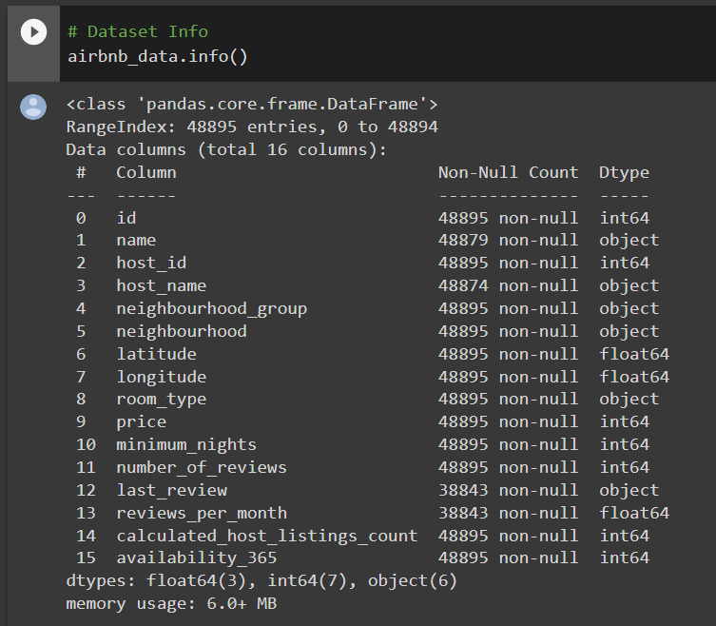
Understanding of Data
These datasets of Airbnb has a 48895 unique listing in New York city in total. The New York city Airbnb dataset contains a very well curated list of room postings from the New York city. These datasets has different data type i.e. int64, float64, object. Also our datasets has so many null values.
Although it would be nice to have few more features about the rooms, users, comments, etc.
Airbnb Dataset Link - https://drive.google.com/file/d/1ioU5r9KEYSfwgfUi22SclVkx4l1a_8ou/view

Slide 11
Our data has 48895 rows and 16 columns in which some of the variables are numerical and some of the variables are categorical which are as follows :-
Understanding of Variables
Numerical Variable
Categorical Variable
host_id
Latitude
Longitude
price
minimum_nights
number_of_reviews
reviews_per_month
calculated_host_listings_count
availability_365
name
host_name
neighbourhood_group
neighbourhood
room_type

Slide 12
Understanding of Variables (Cont.)
id - unique listing id
Name - Represents Accommodations
Host id - Unique id for hosts
Host Name - Registered name for hosts
Neighbourhood Group - Group of area/Locations
Neighbourhood - Area under neighbourhood group
Latitude - location of listing
Longitude - location of listing
Room Type - unique types of each room
Price - price of properties in dollar
Minimum Nights - minimum nights stay required for single visit
Number Of Reviews - total rating
Last review - latest review given
Reviews Per Months - ratings received per month
Calculated Host Listings Count - total number of properties registered under hosts
Avaliability_365 - number of days for which host is available in a year for bookings

Slide 13
Python Libraries Used in Project
Numpy – Python library used for scientific computing
Pandas – Python library used for data manipulation
Matplotlib.pyplot – Python library used for data visualization and graphical plotting
Seaborn – Python library used for statistical graphics plotting (visualization)
Folium – Python library used for interactive maps of different types and locations

Slide 14
Data Wrangling (EDA) & Data Visualization with Business Insights
3

Slide 15
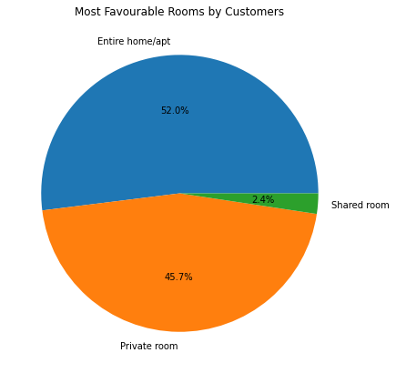
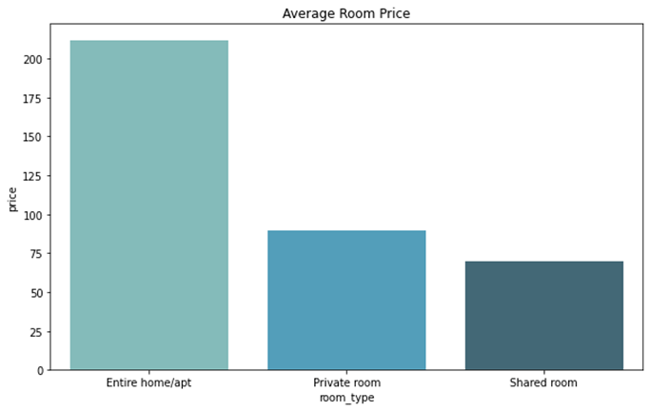
EDA & Visualizations
Que1. Which room type and locality are mostly in demand in NYC ?
As we can see in above graphs that most Favourable Rooms by Customers is either Entire Home /Apartment or Private Room which is high in price also. Shared room is least favourite. Also Average Room Price of Entire Home/Apartment is highest followed by Private room then Shared Room.

Slide 16
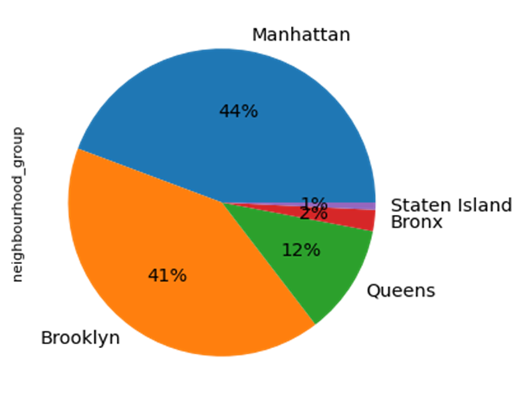
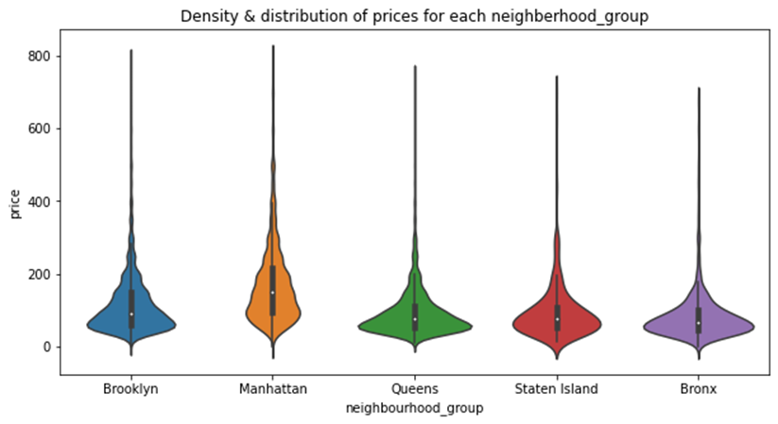
EDA & Visualizations (Cont.)
44% of Customers Preferred Manhattan Neighborhood Group followed by Brooklyn which is 41%, While Staten Island is Least Preferred Location with 1%.
Also Manhattan being the most costliest place to live in followed by Brooklyn. Queens, Staten Island are on the same page with price on listings.

Slide 17
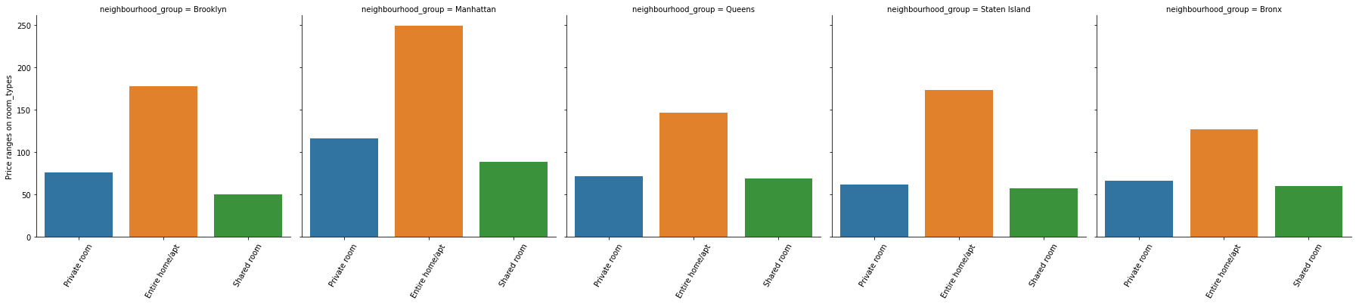
EDA & Visualizations (Cont.)
This graph shows the relationship between neighborhood group and all room types.

Slide 18
Insights

Slide 19
More than 50%
45.7 % customers
Only 2.37%
Prefers Entire Home or Apartment to Stay
Prefers Private room
Prefers Shared room

Slide 20
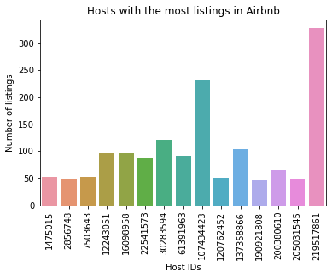
EDA & Visualization (Cont.)
Que2. Top 10 Host with most properties/listing on Airbnb website.
Host with Most listings in Airbnb NYC is 219517861(Host Id).

Slide 21
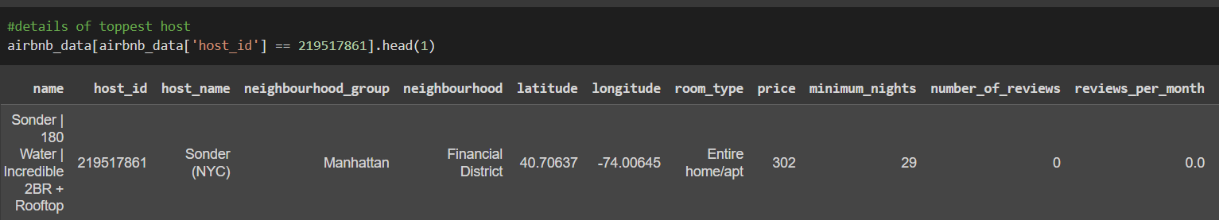
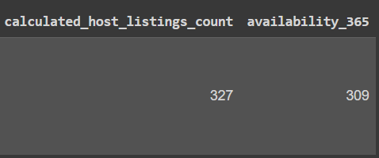
EDA & Visualization (Cont.)
Details of the Top Most Host with Maximum number of listings in Airbnb NYC are :-

Slide 22
Insights

Slide 23
Top Most Hosts
Host Id 219517861 named Sonder(NYC) leads the highest number of listing in New York city, has more than 300 listing in Airbnb.
Host Id 107434423 named Blueground from manhattan neighbourhood group is the second highest number of listing in NYC, which has more than 200 listing.

Slide 24
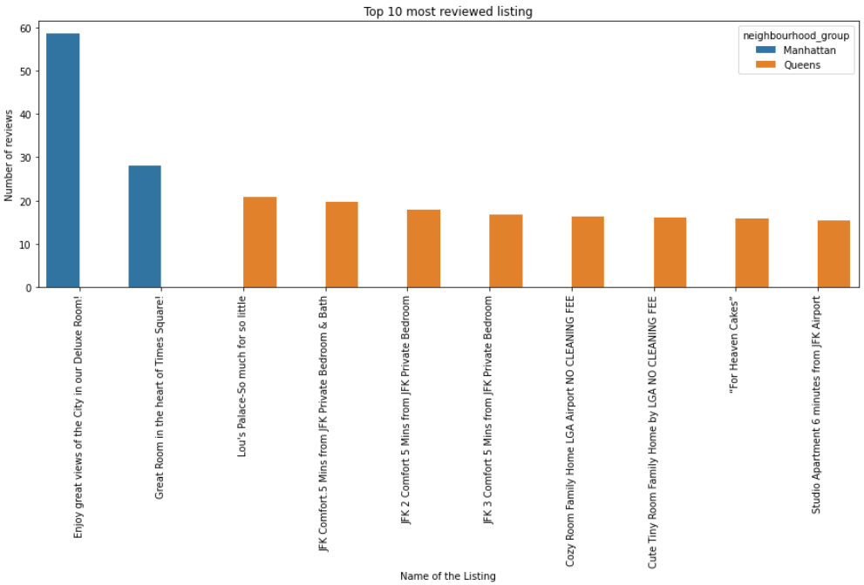
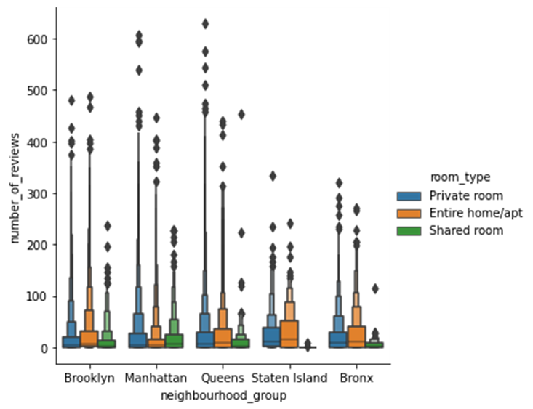
EDA & Visualization (Cont.)
Que3. Top 10 most reviewed properties/listings on Airbnb.
Property with highest number of reviews is Enjoy great views of the City in our Deluxe Room! with 58 reviews/month followed by Great Room in the heart of Times Square! with 27 reviews/month that is from Manhattan.

Slide 25
Insights

Slide 26
Top Most Reviewed Listing
Property with highest number of reviews is Enjoy great views of the City in our Deluxe Room! with 58 reviews/month that is from Manhattan.
Top 2 are from Manhattan so we can decide the best suited place for a comfortable stay but the prices are high to afford.
Manhattan & Queens got the most no of reviews for Entire home/apt room type.
There were less reviews received from shared rooms as compared to other room types and it was from Staten Island followed by Bronx.

Slide 27
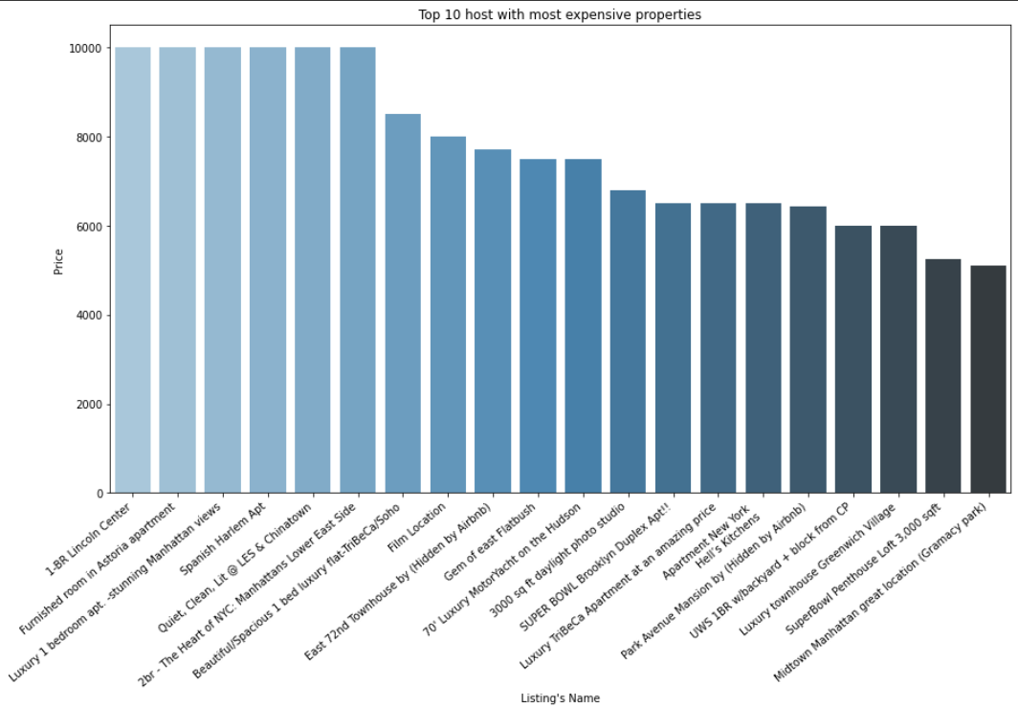
EDA & Visualization (Cont.)
Que4. Most Expensive Property/listings on Airbnb.

Slide 28
Insights

Slide 29
Expensive
Most costly listing is from Luxury 1 bedroom apt. -stunning Manhattan views, 1-BR Lincoln Centre and Furnished room in Astoria apartment which is from Manhattan, Brooklyn and Queens hosted by Erin, Jelena and Kathrine respectively.
200
Average neighborhood group Price of Manhattan is about 200

Slide 30
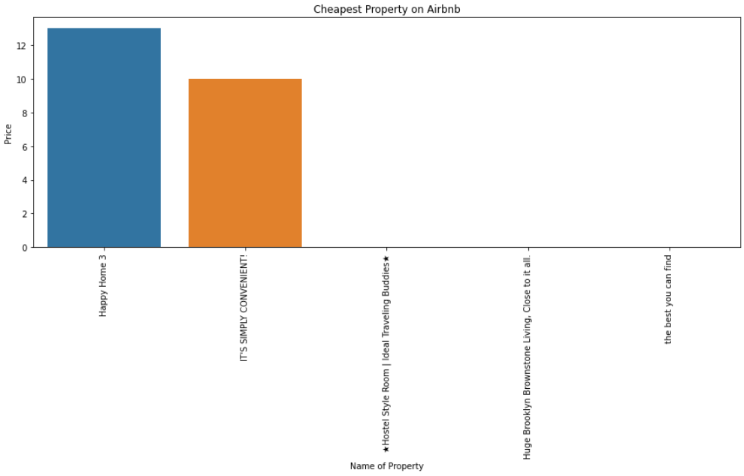
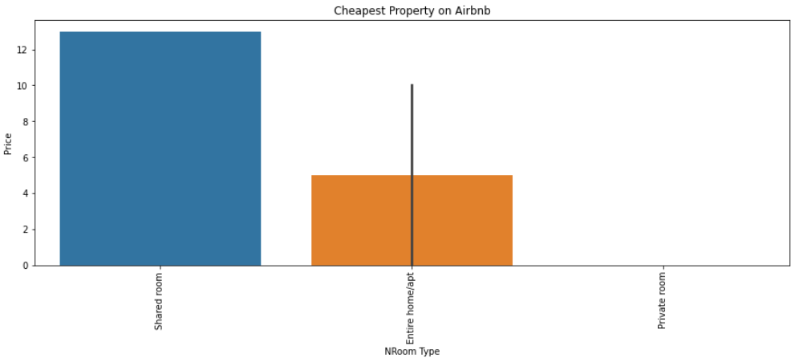
EDA & Visualization (Cont.)
Que5. Which Property type and room type is cheapest (five least) and more available on Airbnb ?

Slide 31
Insights

Slide 32
Cheapest Property
Most cheapest listing is from IT'S SIMPLY CONVENIENT! and Happy Home 3 which is from Queens and Staten Island hosted by Maria and Raquel respectively. As it is cheap property so it will be more available for the customers.
Free Stay
Some of the properties having a price of zero which is either a free stay for specific time or the willingness of not to share the price with the Airbnb.

Slide 33

150 /Day
Same
Cheapest
Highest Average listing Price of Manhattan
Queens and Staten Island have same average price/day
Bronx comes out to be the cheapest neighbourhood group in New York city.

Slide 34
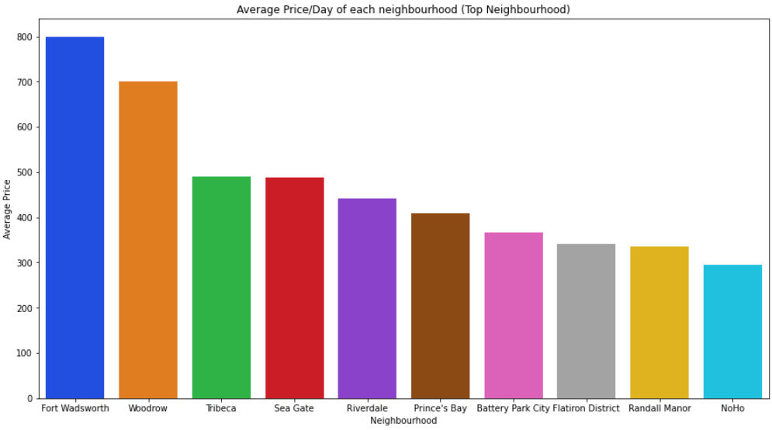
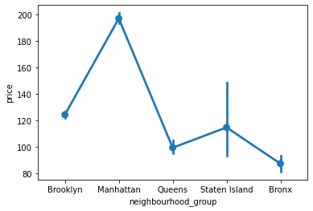
EDA & Visualization (Cont.)
Que6. What is the average price/day of Airbnb listings with respect to neighborhood group and neighborhood in NYC ? (Top neighborhoods in NYC)

Slide 35
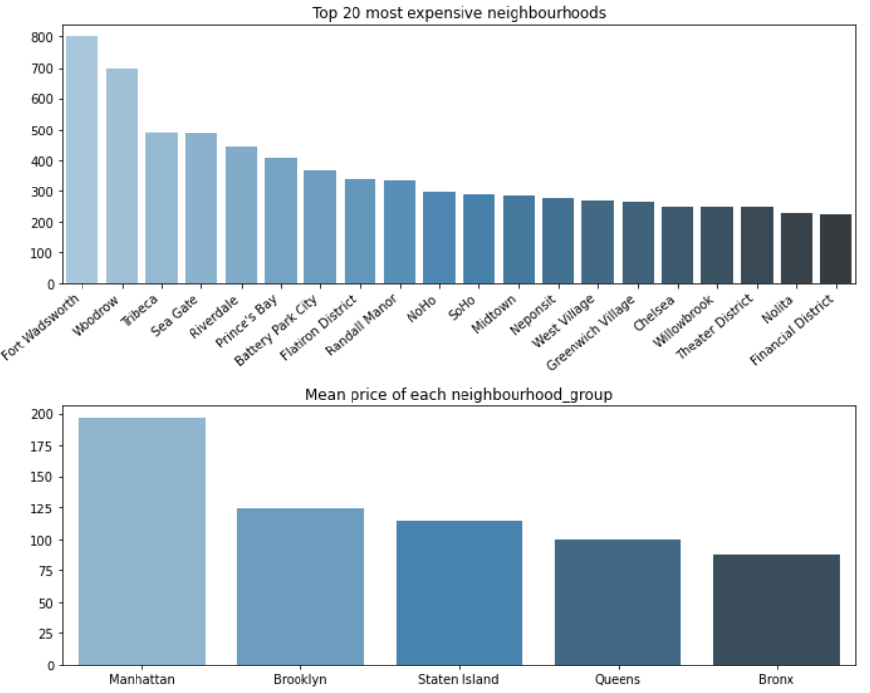
EDA & Visualization (Cont.)
Most Expensive Neighbourhood -
Fort Wadsworth, Woodrow and Tribeca.

Slide 36
Insights

Slide 37
Top Neighborhood
Top Most Expensive Neighbourhood is Fort Wadsworth followed by Woodrow and Tribeca with the mean price of 800$ and 700$.
Manhattan has the highest(the costliest) average of price ranging to 150 dollars/day followed by Brooklyn
Queens and Staten Island have same average price/day
Bronx comes out to be the cheapest neighborhood group in New York city
Bronx has least average price which can have mostly shared room as shared room is less preferred by customers.

Slide 38
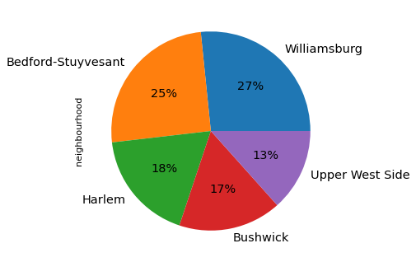
EDA & Visualization (Cont.)
Que7. Any Particular Neighborhood/Location with Maximum no. of Bookings and revenue from room type ?
These are top 5 Hottest Areas where Williamsburg is the hottest area of transaction followed by Bedford-Stuyvesant

Slide 39
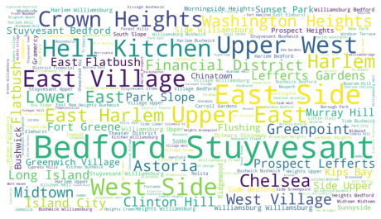
EDA & Visualization (Cont.)
WordCloud -

Slide 40
Insights

Slide 41
Hottest Area of NYC
27% of the total area is covered by Williamsburg Location, having more demand and maximum no. of bookings which further has a expensive room type with the maximum price followed by Bedford-Stuyvesant covering the area of 25% respectively.
Harlem, Bushwick and Upper West Side approximately has same coverage of area that is 18%, 17% and 13% respectively.

Slide 42
From the above visualization, we can definitely come up with some conclusion that most of the time customers are going to prefer this keywords. So that we can easily examine that what exactly the behavior and views of our customers. These also tells us that which of the neighborhood are mostly demanded by customer i.e. this areas comes under the top travel destinations.

Slide 43
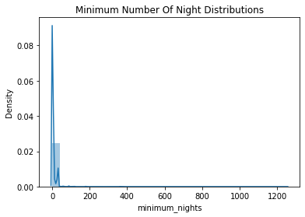
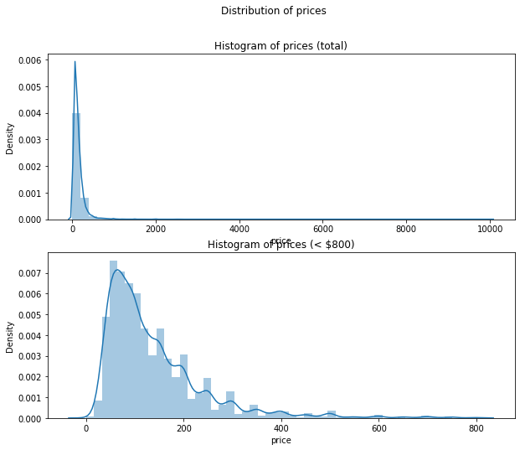
EDA & Visualization (Cont.)
Que8. Distributions of Price and Minimum Number of Nights.

Slide 44
Insights

Slide 45
Minimum Nights with Cost ?
We can see that high number of rooms is there with zero minimum nights and some of them is excessively higher. Also we can say that normal minimum nights is around 2 while at the same time the highest minimum nights tends to be around 30 nights.
Average booking is around 7 nights.
minimum booking is for 1 night.
max booking is for more than a year or we can say for few years.

Slide 46
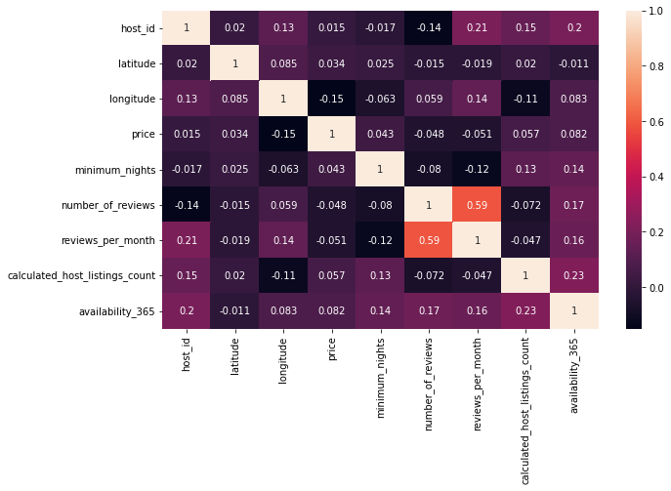
Que9. Relationship Between All the Variables. (Bivariate)
EDA & Visualization (Cont.)
By Using Heatmap, We can see here that apart from number of Reviews & Reviews per Month There is no significant Correlation between any Variables

Slide 47
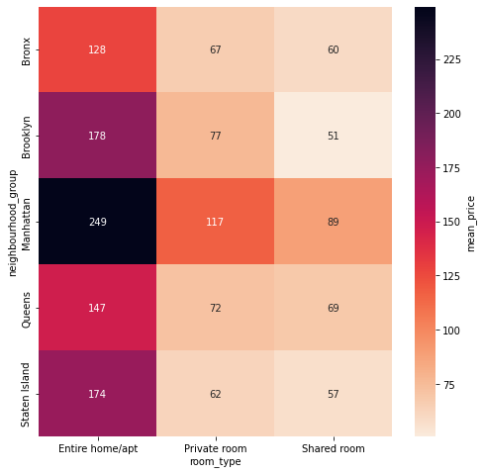
EDA & Visualization (Cont.)
This heat map shows the relationship between neighbourhood_group and room_type value by showing the Average Price of Room type in different Neighbourhood Group

Slide 48
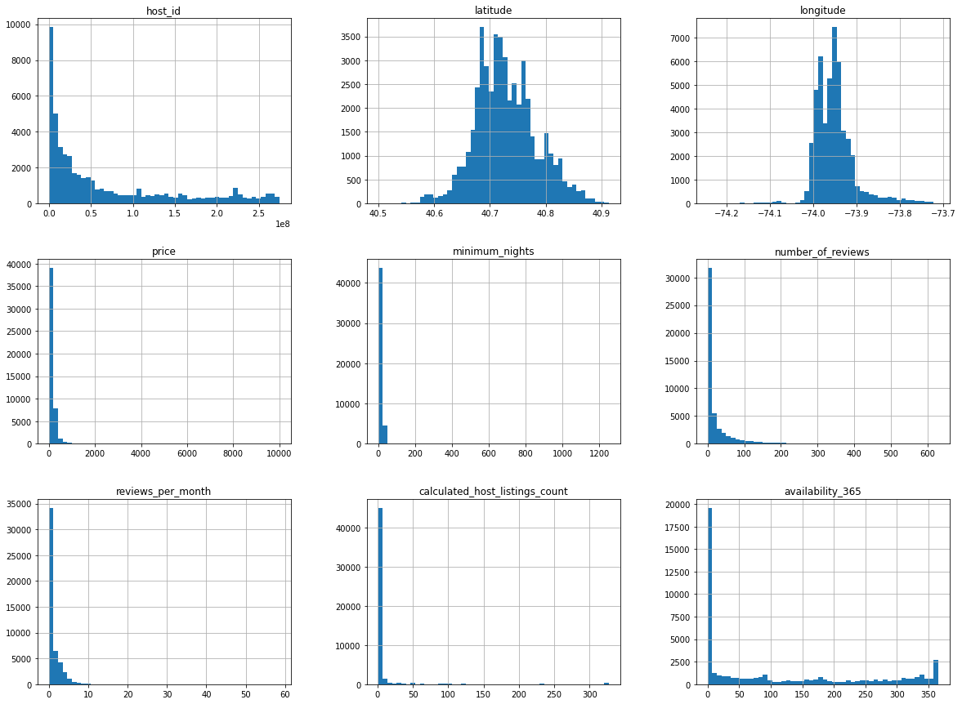
EDA & Visualization (Cont.)
By Using Histogram (Bivariate Variables), We can check relationship between all Numerical Variable

Slide 49
Insights

Slide 50
249
51
59%
With 249 Mean Price of Entire Home / Apartment, Manhattan becomes Most Expensive
With 51 Mean Price of Shared Room, Brooklyn becomes Most Cheapest
co-relation between no_of_review & reviews per month

Slide 51
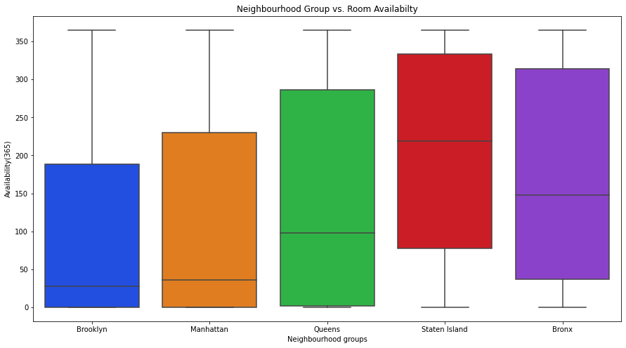
Que10. Availability of a room in each neighbourhood group ?
EDA & Visualization (Cont.)
Rooms Availability in Different Neighbourhood Groups

Slide 52
Insights

Slide 53
More than 300
210
150
Staten island has more availability of rooms throughout the year more than 300 days
on an average this properties are available to around 210 days every year
In Bronx every property are available for 150 days

Slide 54
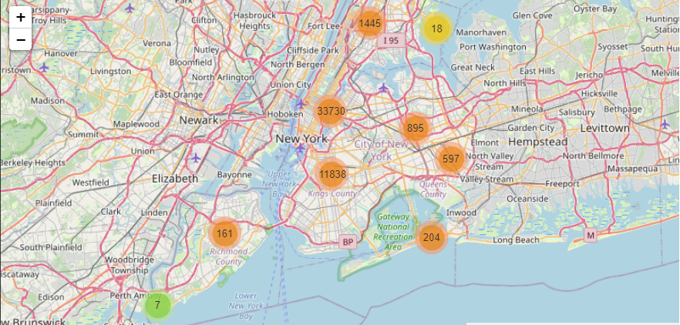
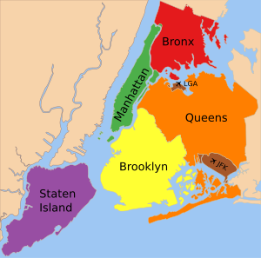
Que11. Map and Scatter Plot of New York City and it’s Neighbourhood Groups & Room Type.
EDA & Visualization (Cont.)

Slide 55
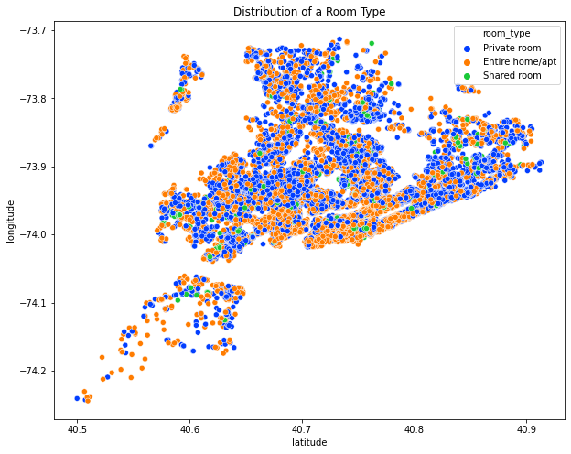
EDA & Visualization (Cont.)
Scatterplots of latitude vs longitude, we can see that there's is very less shared room throughout NYC as compared to private and Entire home/apt. 95% of the listings on Airbnb are either Private room or Entire/home apt.

Slide 56
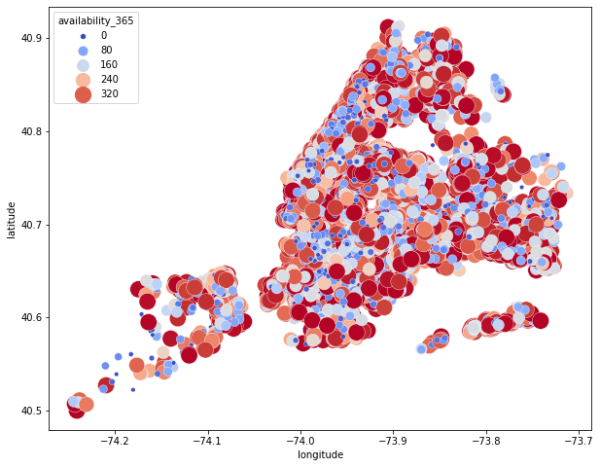
EDA & Visualization (Cont.)
Bronx & Staten Island has listings which are mostly available throughout the year, might be the case as they are not much costlier as compared to other boroughs as in Manhattan, Brooklyn & Queen

Slide 57
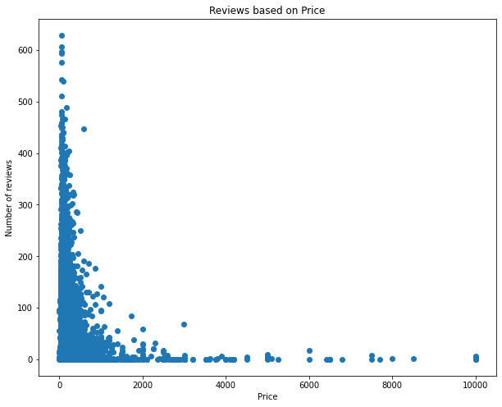
EDA & Visualization (Cont.)
We can clearly see that number of reviews, a listing receives does not have much of an impact on the price

Slide 58
Competitive Advantages and Future Work
5

Slide 59
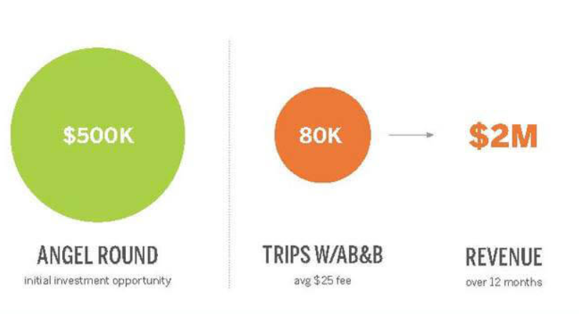
Competitive Advantages :-
Ease of Use – Search by price, locations and check-in/check-out dates
Home Incentive – They can make money by sitting at home
List Once – Hosts post one time only
First to Market – For transaction-based temporary housing site
Profiles and Bookings – Browse profiles of the hosts and book in just few steps
The strategy work on this given flow. With an average transaction fee of $25 the company could easily project $200M in revenue between 2008 and 2011, which is bound to get anyone excited.

Slide 60
Future Work :-
Scrape additional fields such as amenities and compare which amenities in both kind of businesses, comments which can help people to understand the proper insights of that place.
The major problem faced by guest or property owner using Airbnb is the trust factor. Giving your space to a any stranger as a host and staying with strangers at their place as a guest might not be easy. So one can work on it also.

Slide 61
Conclusion
6

Slide 62
In this analysis project, about 10 or more different use cases were analyzed on the given dataset to make better business decisions and help analyze customer trends and satisfaction, which can lead to new and better products and services. It has been found that Most of the Bookings were takes place for the "Williamsburg" of around "27%" followed by "Bedford-Stuyvesant", "Harlem" which has "25%" & "18%" respectively. Additionally, we also find-out the Top Earners (Host), relationship between neighborhood group and Prices, Price comparison in terms of Room Type, Preference of Guests with respect to Room Type. Furthermore, we have also been analyzed Maximum Number of Bookings, Customer Reviews and many more.

Slide 64
THANKS!
Any questions?
You can find me at
https://github.com/riyapatelrp

